Slide 1

Multilayer Monochromators
Manuel Sanchez del Rio
srio@esrf.eu
Advanced Analysis & Precision Unit, MEG/ISDD, ESRF

Slide 2
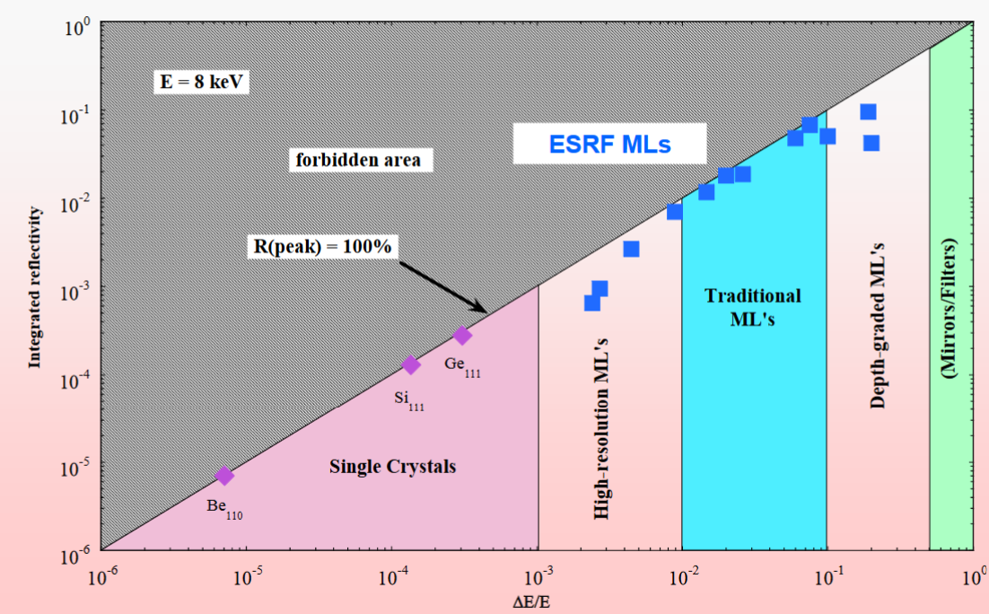
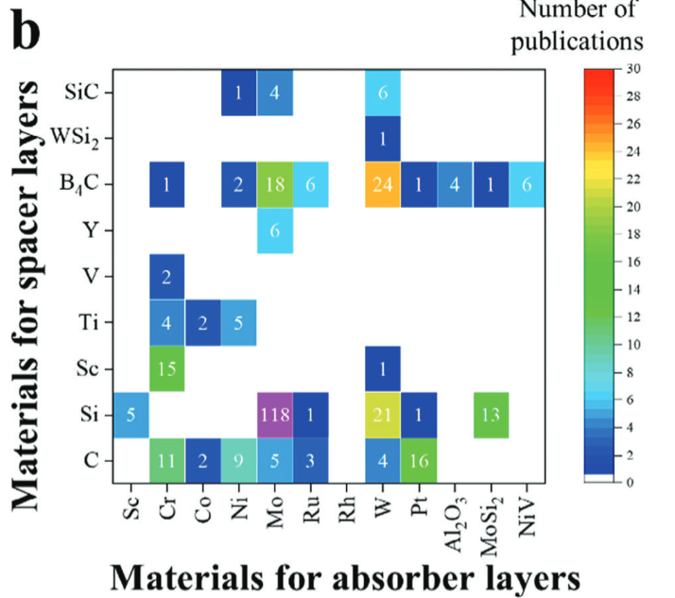
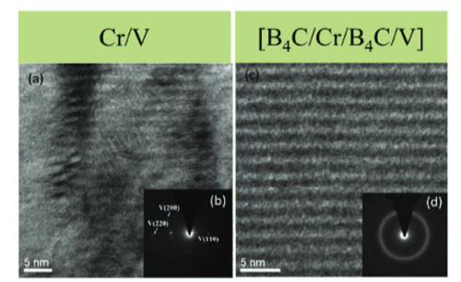
Multilayers
Multilayers are engineered structures composed of alternating thin layers of different materials, typically metals [absorber] and dielectrics [spacers].
Purposes
Enhance the reflectivity at energies and angles where a mirror reflect poorly
White beam mirrors
Focusing optics (KB)
Harmonic rejection
High-band monochromators: lower grazing angles and broader bandwidths than crystals
Materials:
Substrate: Si
Spacer: C, Si, B4C
Absorber: W, Pd, Mo
Technology
Sharp interface (no interdifussion)
Low roughness
https://www.esrf.fr/files/live/sites/www/files/Instrumentation/friday-lectures-slides/Morawe_Friday-lecture1.pdf
https://doi.org/10.1002/admt.202302187

Slide 3
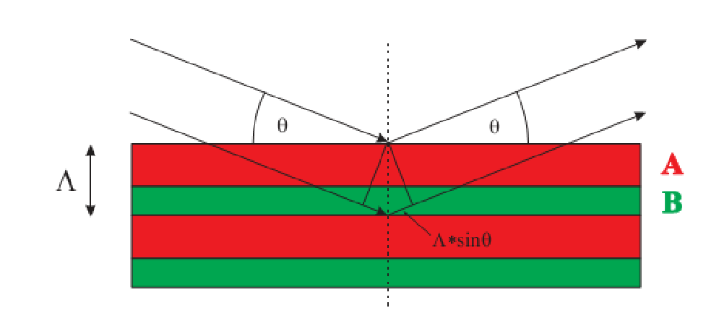
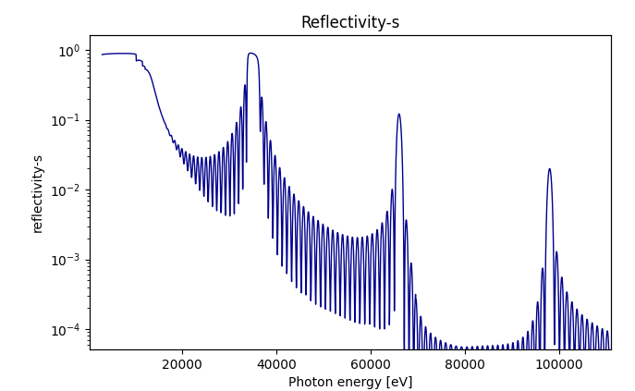
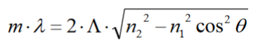
Multilayer Reflectivity
Calculated using Parratt recursive method (1954) https://doi.org/10.1103/PhysRev.95.359
Total reflection
Bragg peaks
Corrected Bragg Law
More layers → narrower bandwidth.
Roughness or diffusion broadens the peak
Kiessig Fringes
Background level

Slide 4
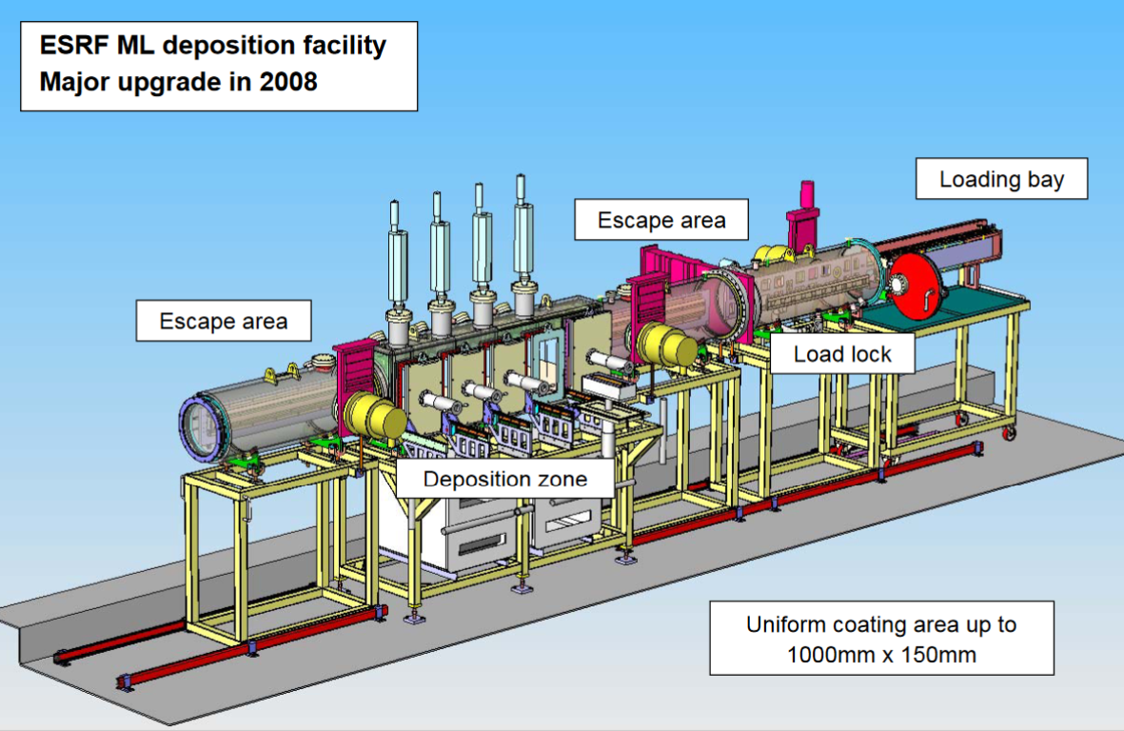
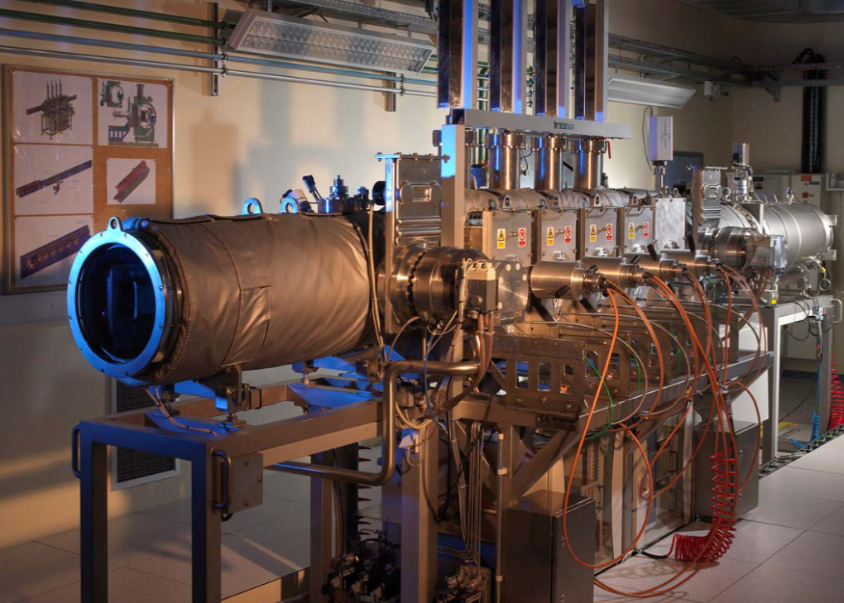
ESRF Multilayer Fabrication Facility
C. Morawe https://www.esrf.fr/files/live/sites/www/files/Instrumentation/friday-lectures-slides/Morawe_Friday-lecture1.pdf

Slide 5
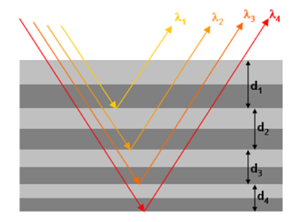
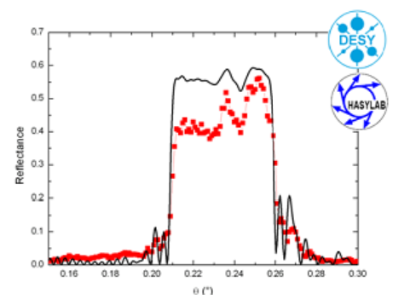
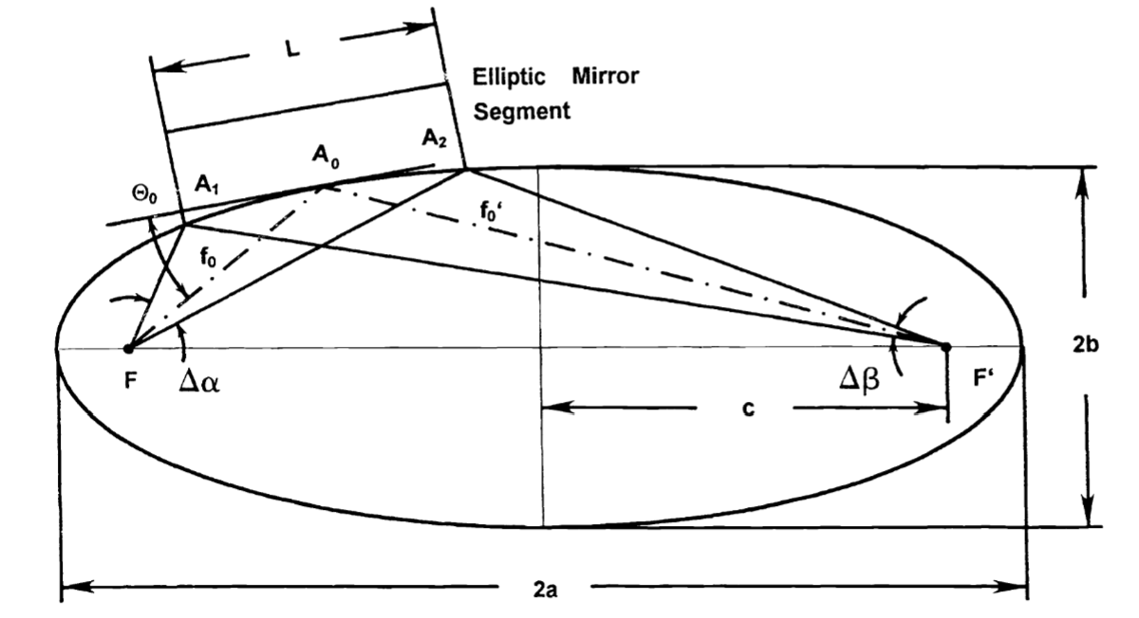
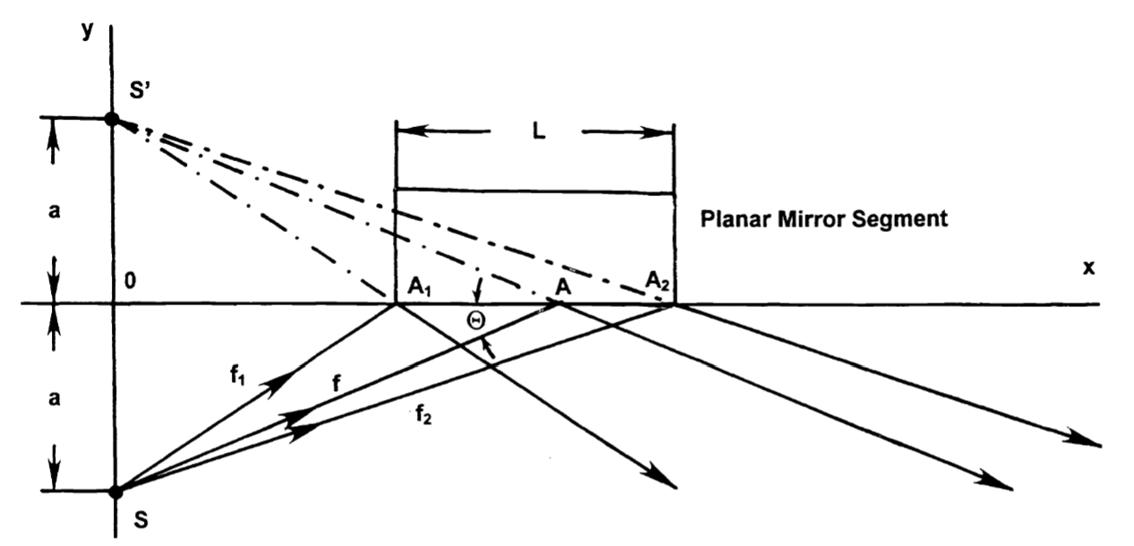
Graded Multilayers
Depth-graded: the bilayer thickness d(z) changes as a function of depth z.
Laterally graded: bilayer thickness varies across the surface (laterally)
https://www.axo-dresden.de/en/products/x-ray-optics/
https://doi.org/10.1117/12.371116

Slide 6
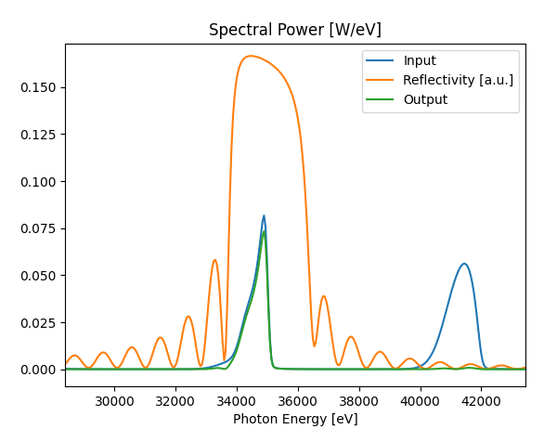
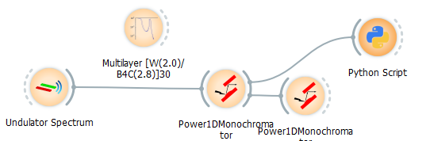
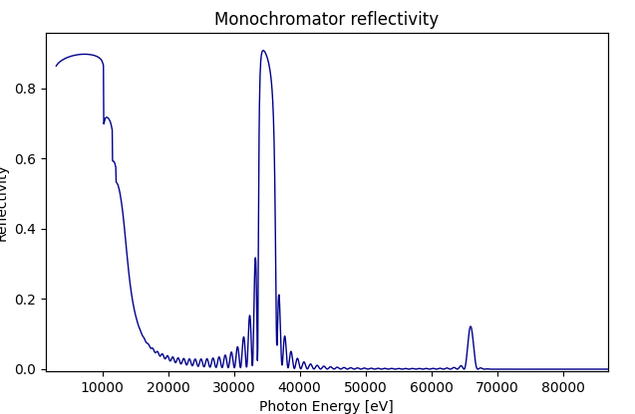
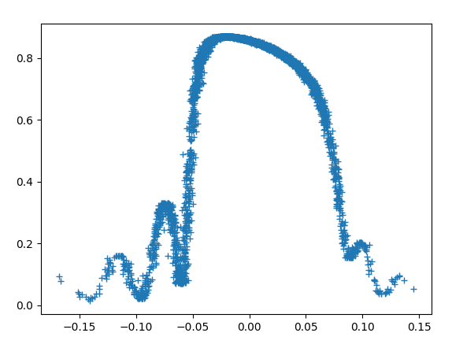
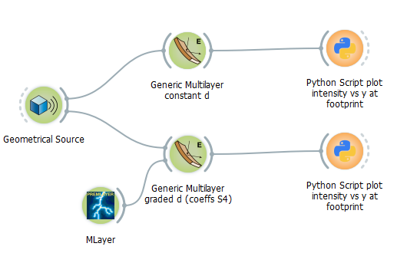
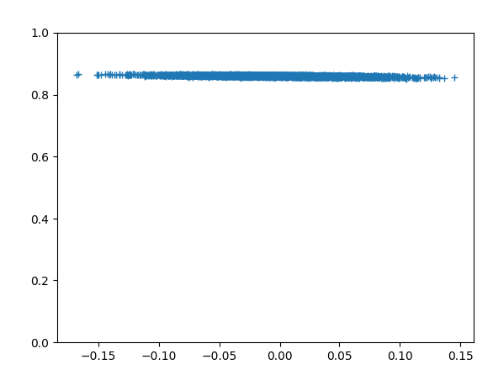
OASYS

Slide 7
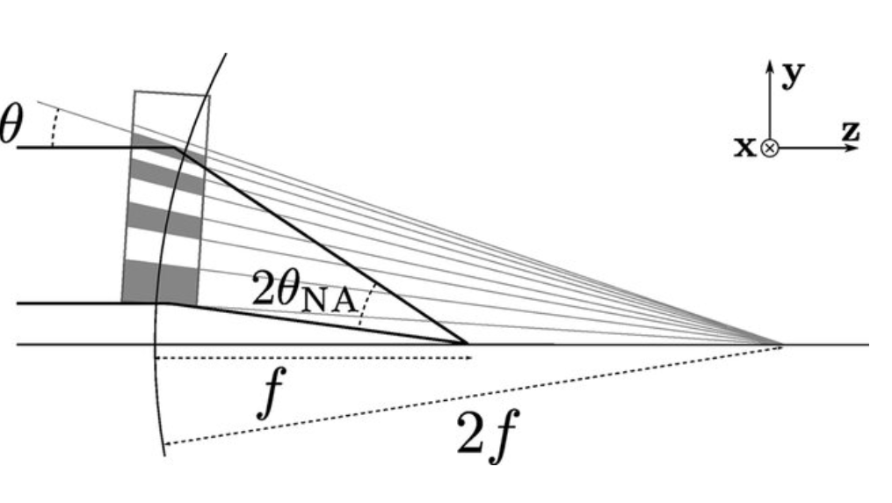
Multilayer Wedged Lens
http://dx.doi.org/10.1107/S1600576720006925

